Slide 1

Module Three: Hackers, ancient and modern
CIS 303 – Prof. C. R. Johnson

Slide 2

History of Cybercrime - 1960s
Before computers became prevalent, “hacking” was a term students at MIT used when they figured out ways to get their model trains to do things they weren’t originally intended to do.
It became a term that meant “applying ingenuity to create a clever result.”
Some of these model train enthusiasts went on to work on some of the very first computing projects, and the term carried over with them. A lot of work in those days was on the cutting edge, and they often found they had to “hack together” a solution to an unexpected problem.

Slide 3
Hacker Ethics
Access to computers—and anything which might teach you something about the way the world works—should be unlimited and total. Always yield to the Hands-On Imperative!
All information should be free
Mistrust authority—promote decentralization
Hackers should be judged by their hacking, not bogus criteria such as degrees, age, race, sex, or position
You can create art and beauty on a computer
Computers can change your life for the better

Slide 4
Hacker Mentality
Note one: Throughout history, but especially in the 70s-90s, politicians fought hard against the degeneracy emerging on the burgeoning internet. Piracy, porn, violent video games, naughty words on records.
Several of them fought to censor media in the name of protecting children – including the Internet. While this is true, see: Law as Social Control. Best that tends to stuck are movie ratings, parental content stickers, ESRB, etc.
This was by no means a “liberal” nor “conservative” ideology, but well-meaning (sometimes) or focus on monetizing (more often) the Internet. Well-meaning or not, the very notion is considered destructive by some.
This drove a fairly large wedge between mainstream American ideals and these groups, creating subcultures, which continued until it became clear we needed some measure of security just to keep things functioning. Some went “white hat” and play by a set of rules deemed acceptable by society. Those that didn’t went “black hat” and went into criminal deviance. Those that still try to play in legal grey areas went “grey hat.”

Slide 5


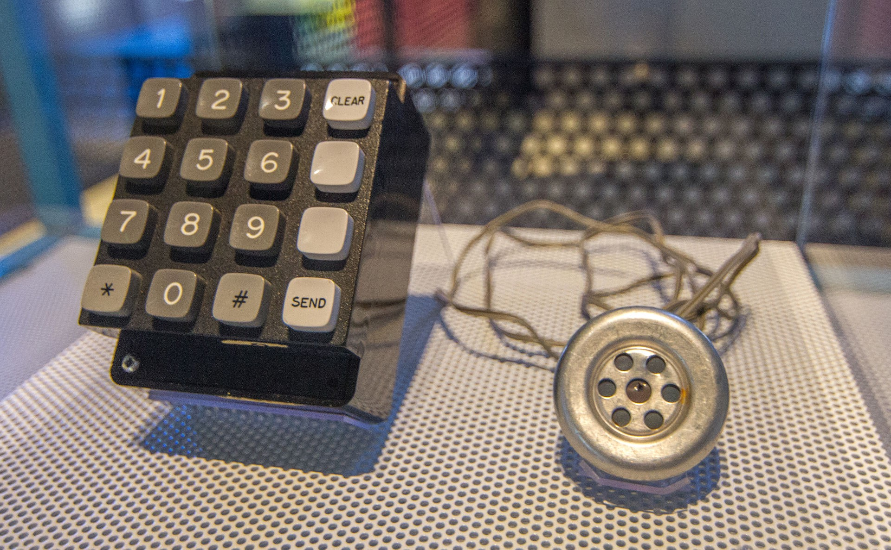
History of Cybercrime - 1970s
The term “hacking” becomes associated with malicious intent thanks to a handful of individuals exploiting these new systems.
Phone phreaking – In the old days of landlines and long distance, some people figured out you could manipulate the phone system for free calls.
By reproducing tones (blue boxing), and digging through phone company trash to find secrets, they learned to exploit the system.

Slide 6
History of Cybercrime - 1970s
One phreak, John Draper (aka "Cap'n Crunch"), learned that a toy whistle given away inside Cap'n Crunch cereal generates a 2600-hertz signal, the same high-pitched tone that accessed AT&T's long-distance switching system.
Draper builds a "blue box" that, when used in conjunction with the whistle and sounded into a phone receiver, allows phreaks to make free calls.
Shortly thereafter, Esquire magazine publishes "Secrets of the Little Blue Box" with instructions for making a blue box, and wire fraud in the United States escalates.
Among the perpetrators: college kids Steve Wozniak and Steve Jobs, future founders of Apple Computer, who launch a home industry making and selling blue boxes.

Slide 7
History of Cybercrime - 1980s
Crimes were mostly petty or pranks – just hobbyists exploring systems.
Phone phreaks begin to move into the realm of computer hacking, and the first electronic bulletin board systems (BBSs) spring up.
The precursor to Usenet newsgroups and e-mail, the boards -- with names such as "Sherwood Forest" and "Catch-22" -- become the venue of choice for phreaks and hackers to gossip, trade tips, and share stolen computer passwords and credit card numbers.

Slide 8
History of Cybercrime - 1980s
Hacking groups begin to form. Among the first are Legion of Doom in the United States, and Chaos Computer Club in Germany.
The movie "War Games" introduces the public to hacking, and the legend of hackers as cyberheroes (and anti-heroes) is born. The film's main character, played by Matthew Broderick, attempts to crack into a video game manufacturer's computer to play a game, but instead breaks into the military's nuclear combat simulator computer.
The computer (codenamed WOPR, a pun on the military's real system called BURGR) misinterprets the hacker's request to play Global Thermonuclear War as an enemy missile launch. The break-in throws the military into high alert, or Def Con 1 (Defense Condition 1).

Slide 9
Chaos Computer Club
One of the few groups with any sort of moral code. It also is probably the oldest- it was founded by a small group of Germans in 1981.
Not only have they survived, but they've been accepted, recognized, and sometimes glorified by the press.
CCC gained notoriety in the 80's when they notified the Deutsche Bundespost of flaws in their online system. Deutsche Bundespost was somewhat of an ideal target for an early hacktivist group, because they actively tried to keep more technologically advanced startups from competing. Deutsche Bundespost's system provider responded by assuring everyone that the system was secure. Of course, CCC still hacked the system and stole DM 134,000. They returned the money the next day.

Slide 10
History of Cybercrime - 1980s
1983 (same year as War Games), authorities arrest six teenagers known as the 414 gang (after the area code to which they are traced). During a nine-day spree, the gang breaks into some 60 computers, among them computers at the Los Alamos National Laboratory, which helps develop nuclear weapons.
The hacker magazine 2600 begins regular publication, followed a year later by the online 'zine Phrack. The editor of 2600, "Emmanuel Goldstein" (whose real name is Eric Corley), takes his handle from the main character in George Orwell's "1984." Both publications provide tips for would-be hackers and phone phreaks, as well as commentary on the hacker issues of the day. Today, copies of 2600 are sold at most large retail bookstores.

Slide 11
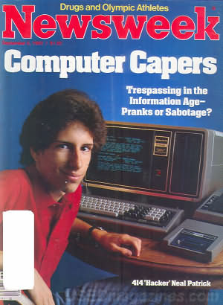
The 414s
One of the original hacking groups in the 1980s. A group of kids 16-22 that met through Explorer Scouts and took their name from the area code of Milwaukee, WI.
They used inexpensive personal computers, analog modems, and simple hacking techniques exploiting the lack of administrative oversight and password care for systems.
Gerald Wondra, 22 at the time, was the first visited by the FBI. Wondra lived with his mother in West Allis. Wondra said he was "curious, he was just having fun".

Slide 12
History of Cybercrime - 1980s
1986: Use a Computer, Go to Jail
In the wake of an increasing number of break-ins to government and corporate computers, Congress passes the Computer Fraud and Abuse Act, which makes it a crime to break into computer systems. The law, however, does not cover juveniles.
1988: The Morris Worm
Robert T. Morris, Jr., a graduate student at Cornell University and son of a chief scientist at a division of the National Security Agency, launches a self-replicating worm on the government's ARPAnet (precursor to the Internet) to test its effect on UNIX systems.
The worm gets out of hand and spreads to some 6,000 networked computers, clogging government and university systems. Morris is dismissed from Cornell, sentenced to three years' probation and fined $10,000.

Slide 13
History of Cybercrime - 1980s
1989
A hacker is arrested who calls himself "The Mentor." He publishes a now-famous treatise that comes to be known as the Hacker's Manifesto. The piece, a defense of hacker antics, begins, "My crime is that of curiosity ... I am a hacker, and this is my manifesto. You may stop this individual, but you can't stop us all."

Slide 14
History of Cybercrime - 1990s
1990: Operation Sundevil
After a prolonged sting investigation. The arrests involve organizers and prominent members of BBSs and are aimed at cracking down on credit-card theft and telephone and wire fraud. The result is a breakdown in the hacking community, with members informing on each other in exchange for immunity.
1993: Why Buy a Car When You Can Hack One?
During radio station call-in contests, hacker-fugitive Kevin Poulsen and two friends rig the stations' phone systems to let only their calls through, and "win" two Porsches, vacation trips and $20,000.
Poulsen, already wanted for breaking into phone-company systems, serves five years in prison for computer and wire fraud. (Since his release in 1996, he has worked as a freelance journalist covering computer crime.)

Slide 15
History of Cybercrime - 1990s
1994: Hacking Tools R Us
The Internet begins to take off as a new browser, Netscape Navigator, makes information on the Web more accessible. Hackers take to the new venue quickly, moving all their how-to information and hacking programs from the old BBSs to new hacker Web sites.
As information and easy-to-use tools become available to anyone with Net access, the face of hacking begins to change.

Slide 16
History of Cybercrime - 1990s
1995: The Mitnick Takedown
Serial cybertrespasser Kevin Mitnick is captured by federal agents and charged with stealing 20,000 credit card numbers. He's kept in prison for four years without a trial and becomes a celebrity in the hacking underground. After pleading guilty to seven charges at his trial in March 1999, he's eventually sentenced to little more than time he had already served while he wait for a trial.
1997: Hacking AOL
AOHell is released, a freeware application that allows a burgeoning community of unskilled hackers -- or script kiddies -- to wreak havoc on America Online (AOL). For days, hundreds of thousands of AOL users find their mailboxes flooded with multi-megabyte mail bombs and their chat rooms disrupted with spam messages.

Slide 17
History of Cybercrime - 1990s
1998: The Cult of Hacking and the Israeli Connection
The hacking group Cult of the Dead Cow releases its Trojan horse program, Back Orifice -- a powerful hacking tool -- at Def Con. Once a hacker installs the Trojan horse on a machine running Windows 95 or Windows 98, the program allows unauthorized remote access of the machine.
During heightened tensions in the Persian Gulf, hackers touch off a string of break-ins to unclassified Pentagon computers and steal software programs. Then-U.S. Deputy Defense Secretary John Hamre calls it "the most organized and systematic attack" on U.S. military systems to date.
An investigation points to two American teens. A 19-year-old Israeli hacker who calls himself "The Analyzer" (aka Ehud Tenebaum) is eventually identified as their ringleader and arrested. Today Tenebaum is chief technology officer of a computer consulting firm.

Slide 18
History of Cybercrime - 2000s
2000: Service Denied
Activists in Pakistan and the Middle East deface Web sites belonging to the Indian and Israeli governments to protest oppression in Kashmir and Palestine.
Hackers break into Microsoft's corporate network and access source code for the latest versions of Windows and Office.
2001: DNS Attack
Microsoft becomes the prominent victim of a new type of hack that attacks the domain name server. In these denial-of-service attacks, the DNS paths that take users to Microsoft's Web sites are corrupted. The hack is detected within a few hours, but prevents millions of users from reaching Microsoft Web pages for two days.

Slide 19
History of Cybercrime - 2000s
2002: Security hits the mainstream
January: Bill Gates decrees that Microsoft will secure its products and services, and kicks off a massive internal training and quality control campaign.
June: The Bush administration files a bill to create the Department of Homeland Security, which, among other things, will be responsible for protecting the nation's critical IT infrastructure.

Slide 20
History of Cybercrime - 2000s
2004: State-sponsored mayhem
July: North Korea claims to have trained 500 hackers who successfully crack South Korean, Japanese, and their allies' computer systems.
2005: The hammer comes down
April 2: Rafael Núñez (aka RaFa), a notorious member of the hacking group World of Hell, is arrested following his arrival at Miami International Airport for breaking into the Defense Information Systems Agency computer system on June 2001.
September 13: Cameron Lacroix is sentenced to 11 months for gaining access to T-Mobile's network and exploiting Paris Hilton's Sidekick.
November 3: Jeanson James Ancheta, whom prosecutors say was a member of the "Botmaster Underground", a group of script kiddies mostly noted for their excessive use of bot attacks and propagating vast amounts of spam, was taken into custody after being lured to FBI offices in Los Angeles.

Slide 21
History of Cybercrime - 2000s
2007: Nothing safe
June 13: FBI Operation Bot Roast finds over 1 million botnet victims
June 21: A spear phishing incident at the Office of the Secretary of Defense steals sensitive U.S. defense information, leading to significant changes in identity and message-source verification at OSD.
August 11: United Nations website hacked by Turkish Hacker Kerem125.
2008
January 17: Project Chanology; Anonymous attacks Scientology website servers around the world. Private documents are stolen from Scientology computers and distributed over the Internet.
March 7: Around 20 Chinese hackers claim to have gained access to the world's most sensitive sites, including The Pentagon. They operated from an apartment on a Chinese Island.
March 14: Trend Micro website successfully hacked by Turkish hacker Janizary (aka Utku).

Slide 22
Our UnSub
Responsible for 28+ power failures and 20 other service interruptions at various Wisconsin power plants. Causing $800,000 in damages and affecting 30,000 customers.
Was charged with arson for setting a sauerkraut factory on fire.
Avid URBEX - Breaking and entering – picking locks to gain access to disused city property.
Disrupted radio and television broadcasts.
Disabled an air-traffic control system.
Damaged an ISPs computer system (Ultimate Fun World 2)
Sold bootlegged software (Electronic Arts games)
Skipped bail facing the above charges, went underground.

Slide 23
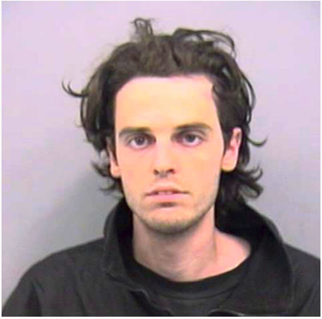
Joseph Konopka
Joseph Konopka
Born: DePere, Wisconsin. 1976
White, male, 18-35, middle-class socioeconomic background
Online moniker: Dr. Ch@os
High-school drop-out, but obtained a GED.
Vocation: Systems Administrator
Leader of “The Realm of Ch@os” – a hacker collective.
Associated with the 2600 collective.
Left his mother’s home in Green Bay after dropping out, went to live on the family farm in DePere.

Slide 24
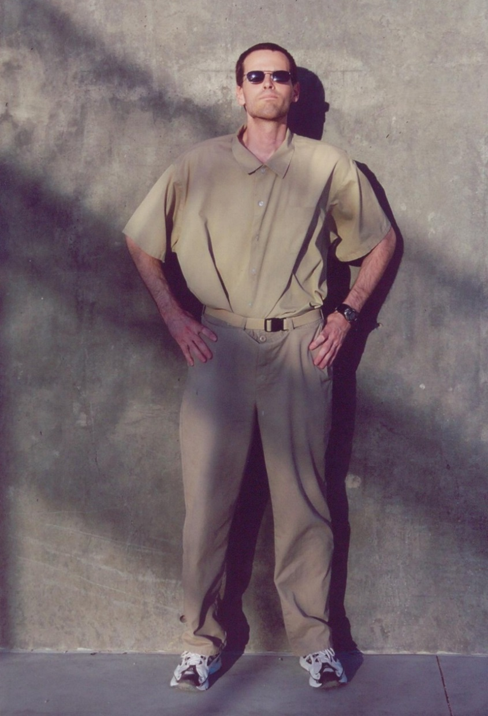
Assorted quotes
When asked why he did it, he said, “I don’t have a real good reason.”
Reported to be “good with computers” and “bored with school – unchallenged by classes and uninvolved socially.” A “good, albeit troubled, kid.”
“I wouldn’t be surprised if he had done something like that to kill himself because he thought his life was over anyway.” – Audrey Konopka, his aunt (Lost $15k in bail when he skipped.)
Persuaded others to join his hacking collective, with the motive that “it was cool.”
His motive seemed to be mischief, “cause some mayhem and see how the authorities react.”
Self-styled “supervillain.”
Letter from Prison

Slide 25
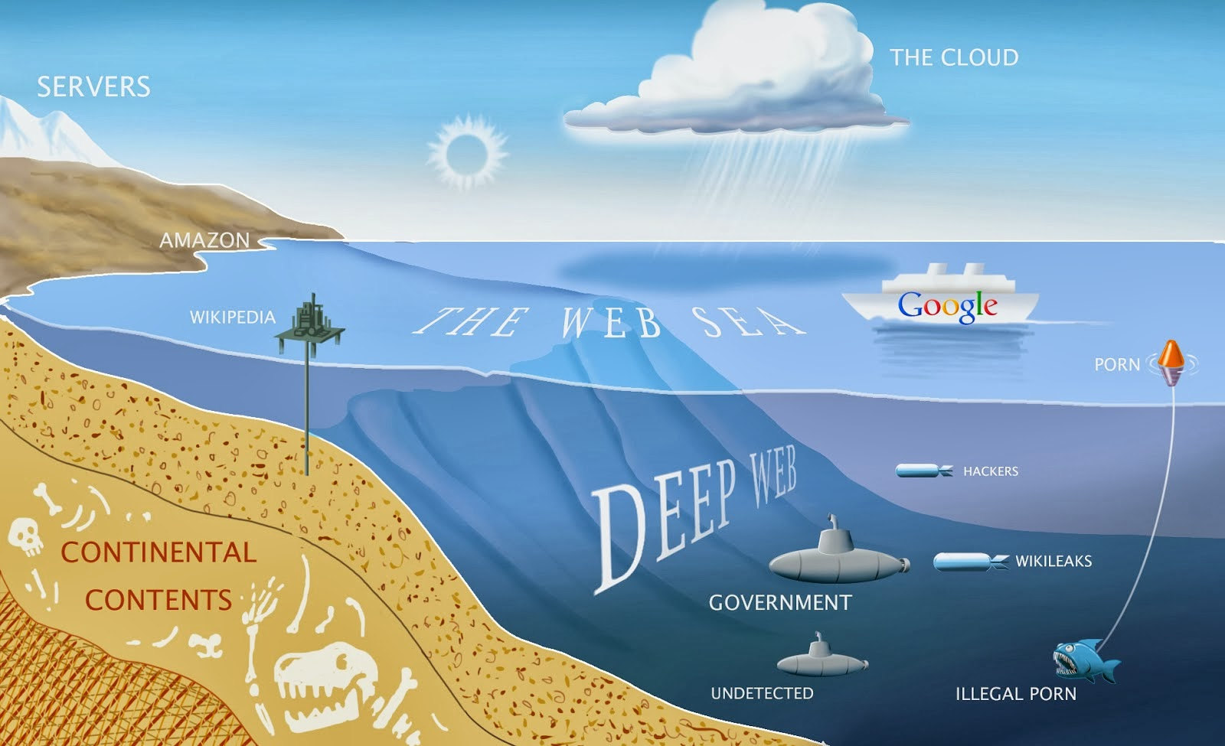
Levels of the internet

Slide 26
Bottom Line: Names to Know
Anonymous
A “hacktivist group” identified in public by wearing a Guy Fawkes Masks. Anons, as they are widely known, have publicized themselves by attacking the government, religious and corporate websites. The Vatican, the FBI, the CIA, PayPal, Sony, Mastercard, Visa, Chinese, Israeli, Tunisian, and Ugandan governments have been amongst their targets.
Since they are a largely decentralized loose collective, they have no real statement or mission, and their target tends to be whatever happens to rile them up at any given moment. However, many of the group members have clarified their intent to attack internet censorship and control.
"Anon" as a name comes from the anonymous image boards (4chan, 8chan, overchan, anon-ib, etc.) where posters do not subscribe with a user account, but posts there are rather posted as "Anonymous"

Slide 27
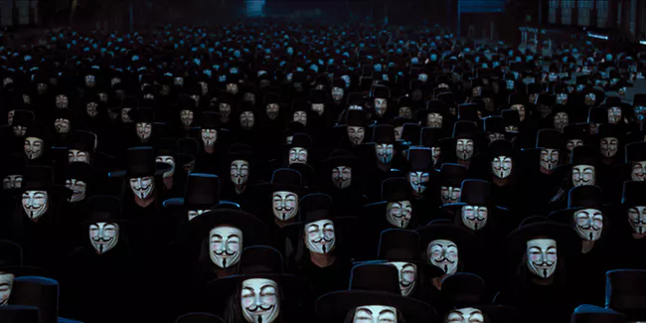
Anonymous Symbolism
Anonymous is identified by the Guy Fawkes mask. The media has made a lot out of this symbol, but the truth is that it is fruitless to search for deeper meaning with a group like this. If you want to understand why they use this symbol, watch the movie "V for Vendetta" (do not read the graphic novel – most members of Anonymous aren't even aware it exists.)

Slide 28
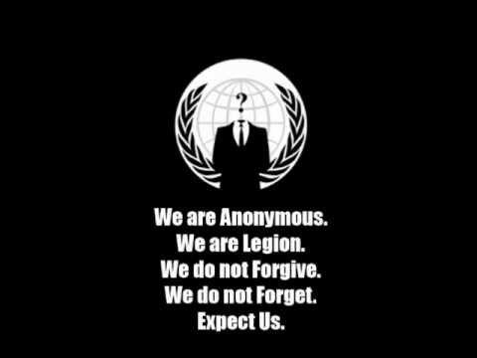
Anonymous Symbolism
They are also identified by the empty suit and the motto "We do not forgive. We do not forget. Expect us." Or similar symbolism. The intent is intimidation. The implication is that Anonymous could be (or is) everyone, anyone, anywhere.
Another popular quote is paraphrased from Palahniuk's Fight Club: "Remember this. The people you're trying to step on, we're everyone you depend on. We're the people who do your laundry and cook your food and serve your dinner. We make your bed. We guard you while you're asleep. We drive the ambulances. We direct your call. We are cooks and taxi drivers and we know everything about you. We process your insurance claims and credit card charges. We control every part of your life."

Slide 29
Anonymous' Goals
Given that they are a loose affiliation of individuals, their targets require something to galvanize their efforts. This means a single (or group of) charismatic individuals with a cause for the collective to rally behind.
This leaves things fairly open. Some targets might be chosen due to outrage (individualized group-think moral panic) or "for the lulz."
By 2017, they now boast over 300 operations of varying success, but with no clear agenda or mission. Their list of ops seems apolitical (or with no clear affiliation) - though a pattern emerges that they detest weakness (defined as both "degeneracy" as well as disability) and anything that limits their access to free expression. It is, for better or worse and in the absence of a better alternative, the apparent conscience of the Internet.

Slide 30
History of Cybercrime - 2010s
2010
January 12: Operation Aurora Google publicly reveals that it has been on the receiving end of a "highly sophisticated and targeted attack on our corporate infrastructure originating from China that resulted in the theft of intellectual property from Google"
June: Stuxnet The Stuxnet worm is found by VirusBlokAda. Stuxnet was unusual in that while it spread via Windows computers, its payload targeted just one specific model and type of SCADA systems. It slowly became clear that it was a cyber attack on Iran's nuclear facilities - with most experts believing that Israel was behind it - perhaps with US help.

Slide 31
History of Cybercrime - 2010s
2011
April 17: An "external intrusion" sends the PlayStation Network offline, and compromises personally identifying information (possibly including credit card details) of its 77 million accounts, in what is claimed to be one of the five largest data breaches ever.
Computer hacker sl1nk releases information of his penetration in the servers of the Department of Defense (DoD), Pentagon, NASA, NSA, US Military, Department of the Navy, Space and Naval Warfare System Command and other UK/US government websites.
September: Bangladeshi hacker TiGER-M@TE made a world record in defacement history by hacking 700,000 websites in a single shot.
The hacker group Lulz Security is formed.

Slide 32
Bottom Line: Names to Know
LulzSec
LulzSec or Lulz Security, was a high profile, Black Hat hacker group. They gained credentials for hacking into Sony, News International, CIA, FBI, Scotland Yard, and several noteworthy accounts. While the group claims to have retired, the motto of the group, “Laughing at your security since 2011!” stays alive. There are assertions of the group having hacked into the websites of the newspapers like The Times and The Sun to post its retirement news. Many, however, claim that this group had taken it upon itself to create awareness about the absence of efficient security against hackers.
Since retired, and have had several members of the group exposed and prosecuted.

Slide 33

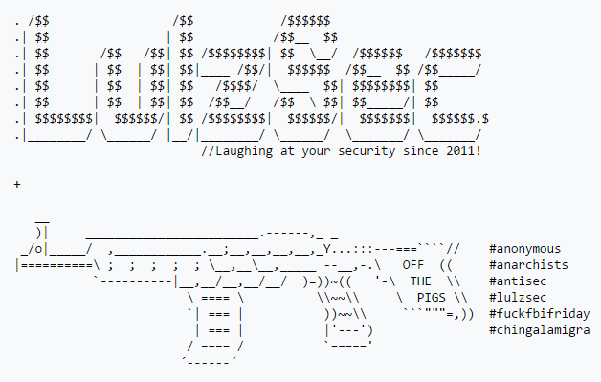
LulzSec Symbolism

Slide 34
History of Cybercrime - 2010s
2012
June 5: The social networking website LinkedIn has been hacked and the passwords for nearly 6.5 million user accounts are stolen by cybercriminals. As a result, a United States grand jury indicted Nikulin and three unnamed co-conspirators on charges of aggravated identity theft and computer intrusion.
August 15: The most valuable company in the world Saudi Aramco is crippled by a cyber warfare attack for months by malware called Shamoon. Considered the biggest hack in history in terms of cost and destructiveness . Carried out by an Iranian attacker group called Cutting Sword of Justice. Iranian hackers retaliated against Stuxnet by releasing Shamoon. The malware destroyed over 35,000 Saudi Aramco computers, affecting business operations for months.
December 17: Computer hacker sl1nk announced that he has hacked a total of 9 countries' SCADA systems. The proof includes 6 countries: France, Norway, Russia, Spain, Sweden and the United States.

Slide 35
History of Cybercrime - 2010s
2013
The social networking website Tumblr is attacked by hackers. Consequently, 65,469,298 unique emails and passwords were leaked from Tumblr. The data breach's legitimacy is confirmed by computer security researcher Troy Hunt.
2014
October: The White House computer system was hacked. It was said that the FBI, the Secret Service, and other U.S. intelligence agencies categorized the attacks "among the most sophisticated attacks ever launched against U.S. government systems."
November 24: In response to the release of the film The Interview, the servers of Sony Pictures are hacked by a hacker group calling itself "Guardian of Peace".

Slide 36
History of Cybercrime - 2010s
2015
June: the records of 21.5 million people, including social security numbers, dates of birth, addresses, fingerprints, and security-clearance-related information, are stolen from the United States Office of Personnel Management. Most of the victims are employees of the United States government and unsuccessful applicants to it. The Wall Street Journal and the Washington Post report that government sources believe the hacker is the government of China.
July: The servers of extramaritial affairs website Ashley Madison were breached.
2016
July 22: Wikileaks published the documents from the 2016 Democratic National Committee email leak.
July 29: a group suspected coming from China launched hacker attacks on the website of Vietnam Airlines.
September: Hacker Ardit Ferizi is sentenced to 20 years in prison after being arrested for hacking U.S. servers and passing the leaked information to members of ISIL terrorist group back in 2015.

Slide 37
History of Cybercrime - 2010s
2017
April: A hacker group calling itself "The Dark Overlord" posted unreleased episodes of Orange Is the New Black TV series online after they failed to extort online entertainment company Netflix.
May: WannaCry ransomware attack started on Friday, 12 May 2017, and has been described as unprecedented in scale, infecting more than 230,000 computers in over 150 countries.
May–July 2017: The Equifax breach.

Slide 38
History of Cybercrime - 2010s
I… Just… Well, look at it:
https://informationisbeautiful.net/visualizations/worlds-biggest-data-breaches-hacks/

Slide 39
Bottom Line: Names to Know
Bureau 121
According to defectors, military hackers live extravagant lives in North Korea. Top students are handpicked from straight out of their "University of Automation" school. The primary wing of this hacking group is known as Bureau 121. It comprises about 1,800 people that work around the world (because internet infrastructure in NK is pretty terrible).
Most of the Bureau's activity has been focused on South Korea. Attacks have ranged from malicious gaming apps targeted at South Korea, hacking the website of the South Korean President, and destroying data of banks and broadcasting companies. Guardians of Peace, the group behind the famous Sony hack might have been a Bureau 121 proxy. That particular hack cost Sony about $15 million.

Slide 40
Bottom Line: Names to Know
Chinese APTs
Elderwood Group, Axiom, Unit 61398, Comment Crew, Putter Panda, Hidden Lynx, and many more. China pioneered the state-sponsored hacking group, and they've continued to perfect the practice.
One of the more famous attacks came in 2010 under the name "Operation Aurora". We in part know about Operation Aurora because Google came forward and announced it had been hacked.

Slide 41
Bottom Line: Names to Know
Dragonfly
Another likely state-sponsored group, this time out of Eastern Europe and Russia, is Dragonfly. Dragonfly is likely state-sponsored due to its targets: electric grids, energy industry, and other control systems in U.S. and Europe.
Their most common attacks are spear-phishing and watering hole attacks. This is not unusual for APT groups. They've also demonstrated capabilities to embed trojans in legitimate software for industrial control systems.

Slide 42
Bottom Line: Names to Know
Tailored Access Operations (NSA)
If it weren't for Edward Snowden, we probably wouldn't know about Tailored Access Operations (TAO). TAO has some of the best capabilities in the world, and has collected about all the American telephone data you can imagine. Once revealed, more and more details have come out about them.
They have sophisticated unique abilities that are difficult to even dream up. One of those capabilities is QUANTUMSQUIRREL, which allows them to appear on the internet anywhere as anyone. They've also compromised very common computer systems often with physical access or cooperation with network or hardware companies. They are known to force companies to insert vulnerabilities into their own systems for TAO to exploit.
Just about all the details of the organization are Orwellian. Take, for example, WARRIOR PRIDE. It's IPhone and Android software that can turn on a phone remotely, turn the microphone of the phone on and listen, track using geolocation, and its own tamper-proofing and stealth programming. That's just one that we know about.

Slide 43
Behavioral Inferences
Affinity for technology.
Trouble with authority.
Few connections to family / community.
Anarchist views, nihilistic views
Known mental health issues (isolation/anti-social behavior, depression, paranoia).
Rejection of cultural goals and institutionalized means.

Slide 44
Antecedents of a Computer Criminal
Anti-social behavior
Drop-outs, high intellect but poor grades
Potential disciplinary issues, prior arrests, or issues with school authorities
Few friends
Dysfunctional family/home life
One or more defining tragic events – lost a parent, child of divorce, revelation of adoption, half-siblings, etc.
Feeling marginalized, deindividualized, etc.
Bullied
Isolated

Slide 45
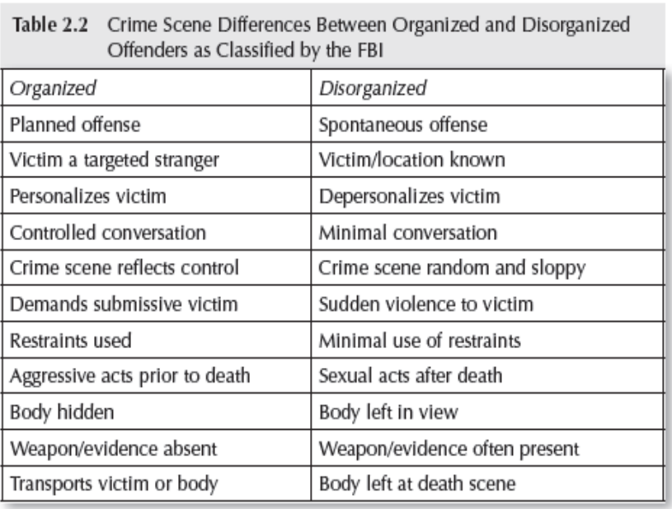
Organized vs Disorganized

Slide 46
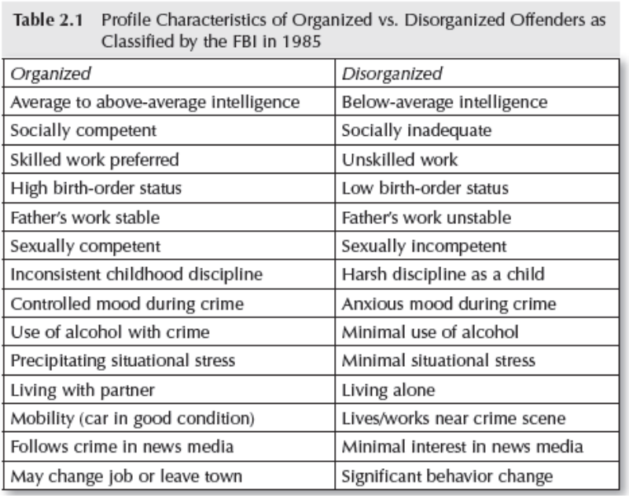
Organized vs Disorganized

Slide 47
Organized vs. Disorganized Computer Crime Scenes
Organized
Efficient code with comments
Use of counter-forensics
Effort to conceal activity or erase trail
Carefully selects a victim, takes time to work their way in
Disorganized
Extraneous / nonsensical code
No apparent forethought or planning
No effort to conceal intrusion or activity
Goes after low-hanging fruit

Slide 48
General Strain Theory
A theory that describes that human behavior is motivated by “strains” which we respond to – negative or positive.
Described that there are four strains that likely lead to criminal behavior:
1) Strains seen as unjust.
2) Strains are high in magnitude.
3) Strains associated with low social control.
4) Strains that create pressure or incentive to engage in criminal coping.
Notes:
Built off of a theory by Robert Merton, developed by Robert Agnew.
Strains seen as unjust. Like being written up for something they don’t see as their fault.
Strains are high in magnitude. Like major events like death or divorce.
Strains associated with low social control. Like being passed up for a promotion by someone with less experience.
Strains that create pressure or incentive to engage in criminal coping. Like getting into heavy debt or fall inw ith bad influences.

Slide 49

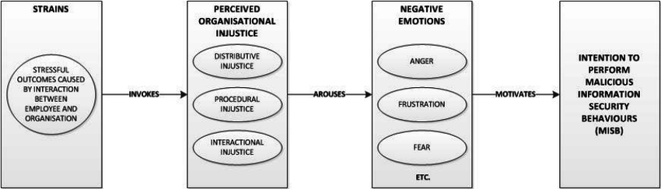
Notes:
Those suffering from this may seek “criminal coping”
Seeking quick profit to “keep up” with the appearance of wealth. For example, theft.
Getting revenge on those they see as the causes of strain. For example, harassment/assault.
Taking their frustration out on others as a way of alleviating these bad feelings. For example, cyber-bullying.
Explains computer crimes that are motives of profit, retributions, or personal in nature…

Slide 50
Types of Strain
Goal Blockage & Disjunction of Expectations
The inability to achieve a goal. A disjunction between aspirations and justice.
An inside actor that may feel disgruntled due to feeling they’ve reached a dead-end in their career or have faced denial for advancement, or reality has not lived up to expectations.
2018 Tesla leak – Disgruntled employee leaks sensitive and proprietary information after being passed up for a promotion.

Slide 51
Types of Strain
Presentation of noxious stimuli or loss of positive stimuli
An unpleasant, unexpected, or unwanted change in their environment.
An insider actor may feel disgruntled due to a perceived “loss of value” in their position.
2014 Morrison leak – Disgruntled employee leaks employee database following disciplinary hearing.

